Slide 1
Statewide Meeting
March 26, 2014
Notes:
Carolyn

Slide 2
Robert Wood Johnson Foundation
Northwest Health Foundation
Investing in unique collaborative partnerships with local and regional grantmaking foundations to encourage sustainable nursing workforce solutions
Notes:
Carolyn – Mention that PIN6 is intended to demonstrate implementation of IOM recommendations

Slide 3
Care Transitions Education Project
Grantee MA Senior Care Foundation
Timeline Sept 1, 2011 – Aug 31, 2014
Budget $450,000
Partners 23 organizations
Project Co-Investors
Partners Investing in Nursing’s Future -- Collaborative of Robert Wood Johnson Foundation & Northwest Health Foundation
Massachusetts Senior Care Foundation
Irene E. & George A. Davis Foundation
Home Care Alliance of MA
Regional Employment Board of Hampden Co.
Healthcare Workforce Partnership of Western MA
United Way of Pioneer Valley
Commonwealth Corporation
Notes:
Carolyn
National Funders
IOM Report Recommendations

Slide 4
Care Transitions Education Project
Notes:
Carolyn
Longstanding tenant of our work: Service and education working together to solve nursing workforce issues that no one organization can solve alone
Would take the chance to thank all of the members of the Steering Committee, Curriculum, and Evaluation Committees and comment on the level of commitment and time from all of these institutions.

Slide 5
Project Overview
Notes:
Laurie

Slide 6
Background Massachusetts Landscape in 2011
Care Transitions Education Project
We envision a future in which person-centered care in Massachusetts is organized around regions and communities, with integrated and coordinated systems of care across settings, and where flow of patient information is seamless and secure among all of a patient’s providers and accessible, in a secure fashion, to patients.
– Massachusetts Strategic Plan for Care Transitions, February 2010
6
Notes:
Laurie
State vision already cast. Lots of focus and attention from state leadership.

Slide 7
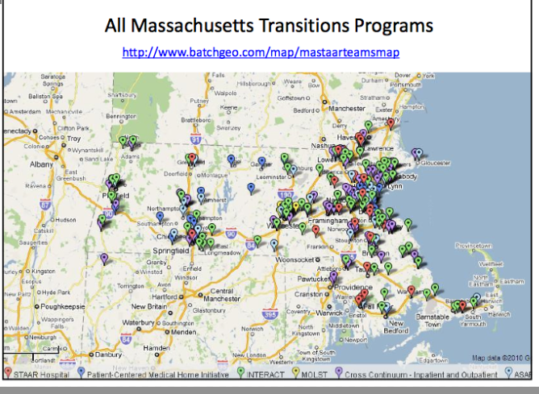
Care Transitions Education Project
PLUS
The Care Transitions Model (Coleman)
Project RED
BOOST
7
Notes:
Laurie
This is what the Mass landscape looked like when we started.
Lots of effort to coordinate and collaborate across projects. Many efforts to reduce readmisssions.

Slide 8
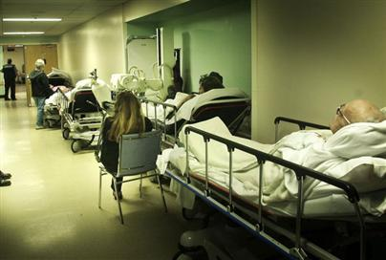
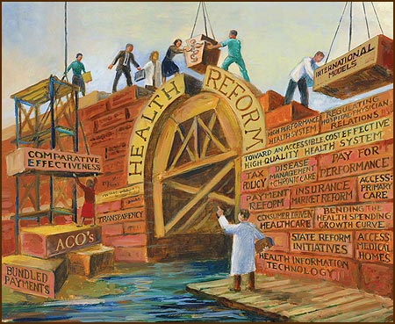
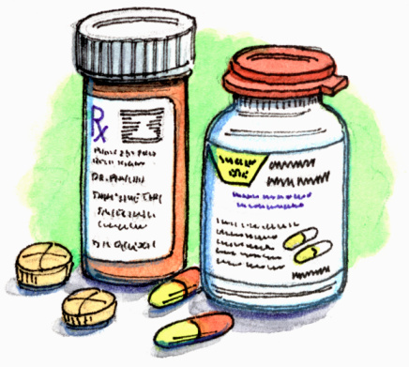
Why All The Focus On Care Transitions?
Care Transitions Education Project
8
Notes:
Laurie
Patient and system level drivers

Slide 9
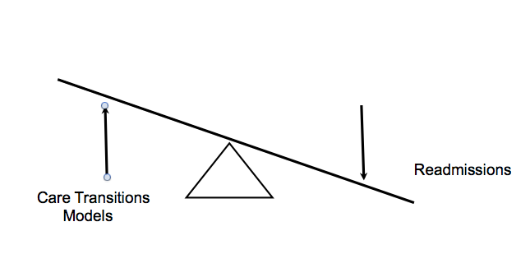
The Care Transition Readmission Connection
Care Transitions Education Project
9
Notes:
Laurie
Here is the idea that really helped providers, payers, and policy makers come together to address the issue:
The connection between care transitions and readmissions.
The idea was, and still is, that if we collectively improve care transitions, we will see a reduction in readmissions and this is good for the patient and good for the system.

Slide 10
Barriers to Effective Care Transitions
Care Transitions Education Project
Structural
Procedural
Performance Measurement
Lack of integrated care systems
Lack of longitudinal responsibility
Lack of standardized forms and processes
Incompatible information systems
Lack of care coordination and team-based training
Ineffective communication
Failure to recognize cultural, educational or language differences
Processes are not patient-centered nor longitudinal
Underuse of measures to indicate optimal transitions
Compensation and performance incentives misaligned
Payment for volume rather than incentivized for outcomes
10
Notes:
Laurie
Lest we think that improving care transitions is simple: the statewide plan clearly articulated all of the potential barriers.
The combined efforts of all of these programs would be more effective in overcoming the many barriers to effective care transitions than any one intervention alone

Slide 11
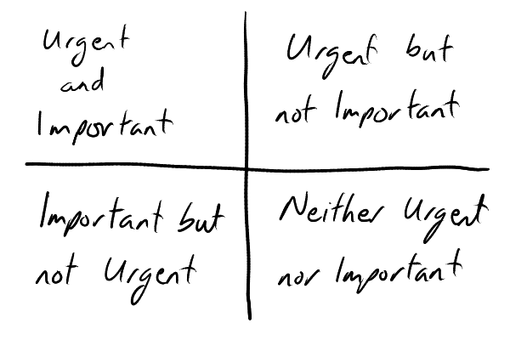
New Language
Care Transitions Education Project
Cross Continuum Team
Care Transitions Collaborative
STAAR
INTERACT
Care Transitions Coach
“Teach Back”
“Warm hand offs”
Healthcare Literacy
11
Notes:
Laurie
We were seeing new language become part of the day to day discussions within and across institutions as a result of all of the work going on.
At this point, the focus on care transitions had clearly become important, but was not urgent

Slide 12
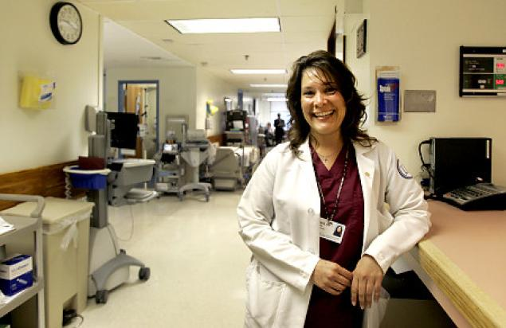
Emerging Leaders
Care Transitions Education Project
The “Ah Ha” Moment
Notes:
Laurie
It was during the statewide meetings, training sessions, and webinars that we had our “aha” moment.
In every one of the initiatives going on, nurses were taking the lead as day to day leaders for the hospital STAAR teams, as INTERACT champions in the nursing home, as the leaders of Care Transitions collaboratives.

Slide 13
Care Transitions Education Project
The “Ah Ha” Moment
Notes:
Laurie
It seemed like a natural thing for nurses to be taking the lead in this work because so much of what is involved in all of the projects falls under the expertise of nursing: patient and family education; medication management, transition planning, warm handovers---fall under the role of the nurse already BUT we weren’t sure if nurses had any formal training on care transitions, and more importantly, how to lead systems change within their institutions.
So, CTEP was born.

Slide 14
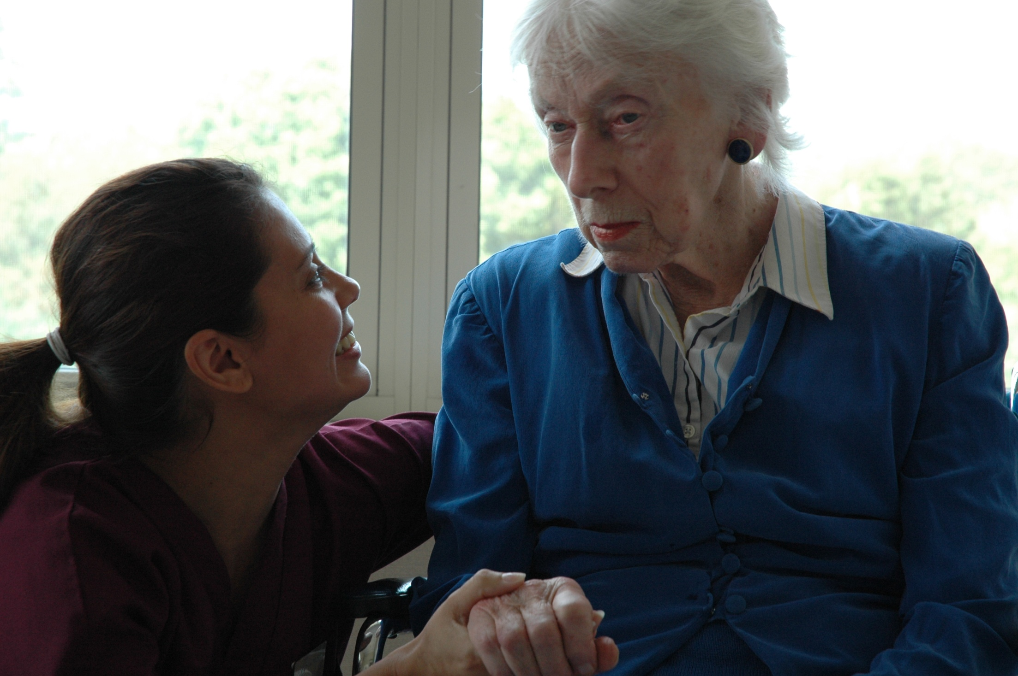
Equipping nurses across all settings and roles to lead effective patient-centered care transitions
Notes:
Laurie
Our visions when we began was to ….
Why nurses?
Because they were already involved and taking the lead.
Because nurses represent the largest group of healthcare providers across the system
Because nurses are charged with carrying out many of the activities necessary for an effective care transition BUT LACK FORMAL, COMPREHENSIVE TRAINING ON CARE TRANSITIONS.
So—nurses have been our focus to date.

Slide 15
Care Transitions Education Project
Year 1
9/11-9/12
Year 2-3
9/12-12/13
Year 3
1/14 - 8/14
Curriculum Development
Pilot Curriculum & Evaluate
Statewide Dissemination
Project Objectives
Increase competency to lead and improve care transitions
Increase mutual respect across care settings
Improve coordination and collaboration
Demonstrate nurse-led quality improvement
Notes:
Laurie
Increase competency of novice and experienced nurses and nursing students to lead and improve care transitions
Increase mutual respect among nurses across care settings in order to establish shared accountability for successful patient care outcomes
Improve coordination and collaboration among cross-continuum team members/inter-professional health providers and educators to achieve successful care transitions
Demonstrate nurse-led quality improvement in care transition practice and work processes that result in positive change

Slide 16
Care Transitions Education Project
Better Care  Better Health  Lower Costs
Nurses in All Settings & All Roles Leading & Improving Care Transitions
Knowledge
Skills
Attitude
Foundational
Foundational
Foundational
Foundational
Foundational
Notes:
Laurie
We designed a unique education program that equips nurses in all care settings and all roles with the foundational knowledge, skills and attitudes required to lead and improve care transitions.

Slide 17
Care Transitions Education Project
Curriculum Components
1
Four Interactive Learning Modules
2
Patient Tracer Experience
3
Quality Improvement Activity
Notes:
Laurie
Expand a bit on each component
For Learning Modules: principles of adult learning, interactive, customizeable
For Tracer: Seeing transition from the eyes of the patients
For QI Project: Help frontline nurses see how they can drive process improvement with one small test of change that can lead to system change

Slide 18
Module 1: Understanding Care Transitions Across the Healthcare Continuum
Care Transitions Education Project
Interactive Learning Modules
Module 2: The Key Role of Nurses in Patient Care Transitions
Module 3: Systems Thinking in Patient Care Transitions
Module 4: Care Transitions Quality Improvement
Notes:
Laurie
Built on gap analysis and extensive curriculum mapping done by curriculum committee with representatives from service and education informing development
Included input from focus groups
Built on core competencies

Slide 19
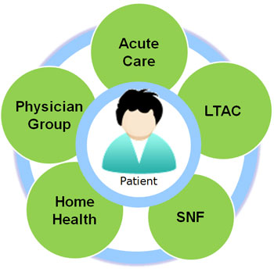
Patient Tracer Experience
Care Transitions Education Project
Focus on patient experience
Visit different care settings
Variety of options
Powerful ‘Ah Ha’ moments
Logistically challenging but worth the effort!
Notes:
Laurie

Slide 20
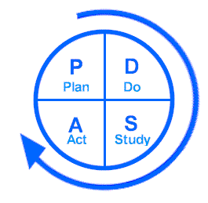
Quality Improvement Activity
Care Transitions Education Project
Identify a care transitions improvement goal
Implement small test of change related to goal
Test of change spans care settings
Opportunity to apply information, tools and strategies learned
Notes:
Laurie

Slide 21
Care Transitions Education Project
Piloting the Curriculum
Eight pilot sites
22 service organizations engaged in cross continuum teams
6 schools of nursing
350 RNs and student nurses
Training for educators
Implement curriculum and evaluate content, delivery & outcomes
Notes:
Kelly
Training is estimated to take approximately 30 hours, with pilots ranging from 24-48 hours including the patient tracer experience
Customizable curriculum
Pilots could include other professions in the training (Social work and LPNs were included)

Slide 22
Care Transitions Education Project
Evaluation
External evaluator
Service and education evaluation experts
Pre/post knowledge test
Relational coordination survey
Curriculum assessment
Learning exchanges between sites
Leadership and learner interviews
Notes:
Laurie
The purpose of this project was to develop and pilot a curriculum that was evidence based, relevant and could be delivered across settings.
We had the benefit of an external evaluator to help inform and guide the project evaluation.
Did pre/post knowledge test
Included a survey designed to measure relational coordination
Collected extensive review of curriculum.
Captured qualitative feedback during 2 learning exchanges and through interviews with trainers and learners.
Could use some text/notes for this slide to be sure I have it right

Slide 23
Care Transitions Education Project
Results
Six of eight (75%) pilot projects demonstrated an increase in knowledge scores from pre- to post-test, four of which were statistically significant increases
68% of learners engaged in a patient tracer experience with many citing its positive impact on their future work in care transitions
Curriculum assessment guided revisions to enhance interactive activities and group discussion opportunities
Notes:
68% of pilot participants engaged in a patient tracer experiential learning activity
The experience will positively impact their future work in care transitions by helping them be more aware and vigilant of the patient, patient education, hazards, decisions and communication

Slide 24
Care Transitions Education Project
Results
44% of learners have more respect for their nursing colleagues in hospitals, SNFs and home care/hospice
63% of pilot leads report evidence of changes in nursing practice that support improvements to care transitions
Pilots cite most valuable CTEP outcome was its impact on nurses’ knowledge, awareness and ability to improve care transitions
Evidence of nurse-led QI initiatives to improve communication and collaboration
Notes:
If they ask…62% of pilot learners indicate that have the “same level of respect” because either 1) they haven’t had enough interaction with nurses in particular settings to increase their respect or 2) they already had a high level of respect for nurses working in other settings.
63% of our pilots reported seeing evidence of changes in nursing practice as a result of CTEP in support of improving care transitions
Using warm handoffs consistently
Increased awareness of patients’ perspectives
More detailed review of discharge materials, instructions and medication lists
Better understanding and demonstration of teach back
One of key success indicators for cross-continuum teams was gaining shared knowledge. The pilots stated that one of the most valuable CTEP outcomes was its impact on nurses’ knowledge, awareness and ability to improve care transitions. The pilots stated that shared knowledge regarding the care transitions process helped nurses to identify areas in need of improvement and awareness of the facts that imped a successful care transitions. Fundamentally that translated into nurses feeling that they have the ability to facilitate and improve systems that support their patients.

Slide 25
CTEP 2014
Care Transitions Education Project
Pioneer
ACO
Risk
Penalties
Rates
Preferred Provider

Slide 26
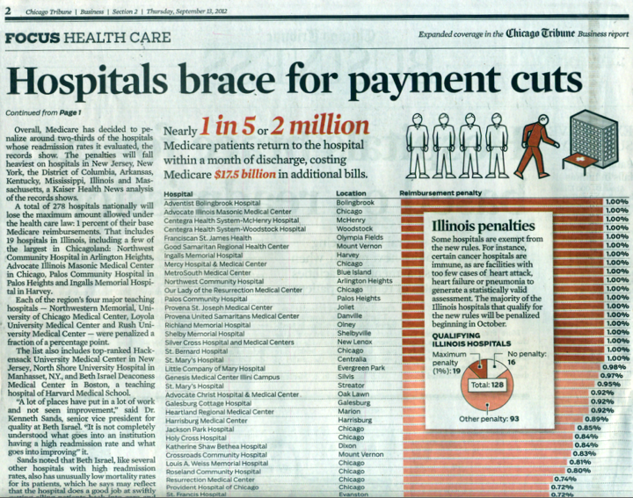
Care Transitions Education Project
Notes:
Laurie
2014 update: things have changed a lot
Long promised payment reform is here, payment penalties are real, and we still haven’t perfected care transitions
The need to improve care transitions is now important and increasingly urgent

Slide 27
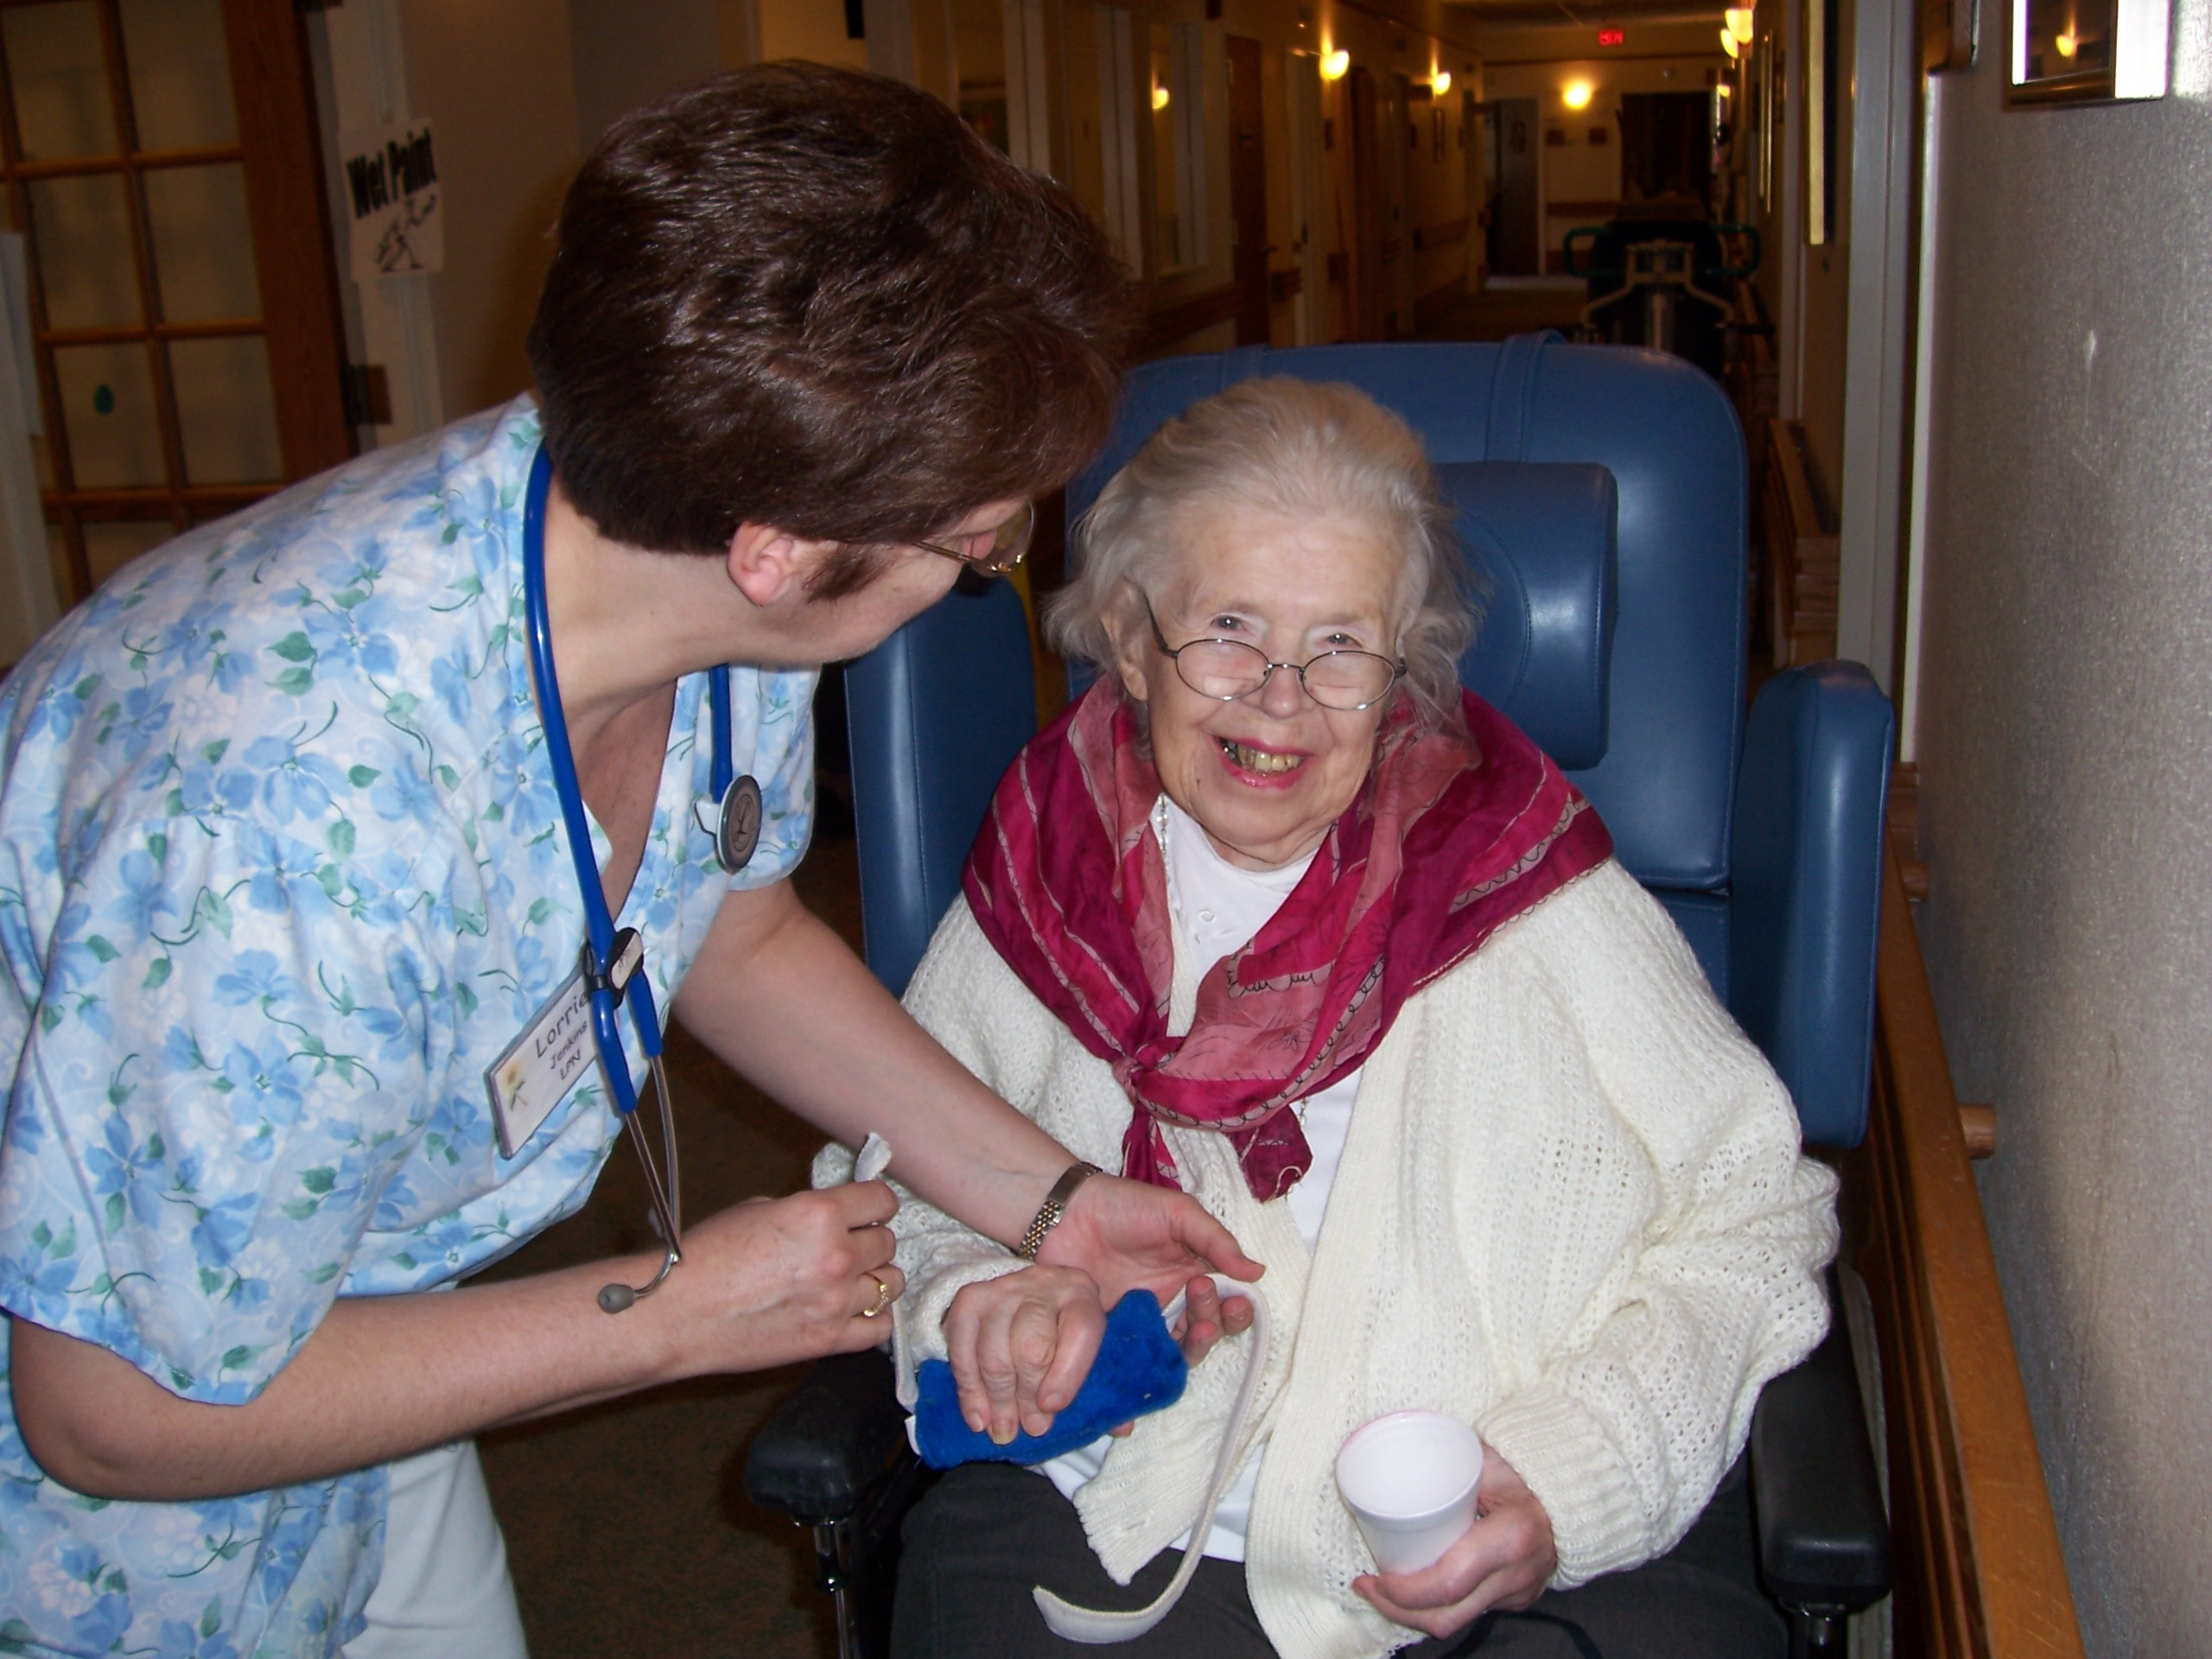
The Time is NOW for your frontline nurses
Notes:
We started out believing that the timing was right to equip frontline

Slide 28
Timing Is Everything: Nurses see the needs of the patient
The Time is NOW for nurses leading teams

Slide 29
Timing Is Everything: Nurses see the needs of the patient
The Time is NOW for your organization
The Time is NOW for your organization

Slide 30
Impact, Outcomes & Stories
Notes:
Introduce Kelly

Slide 31
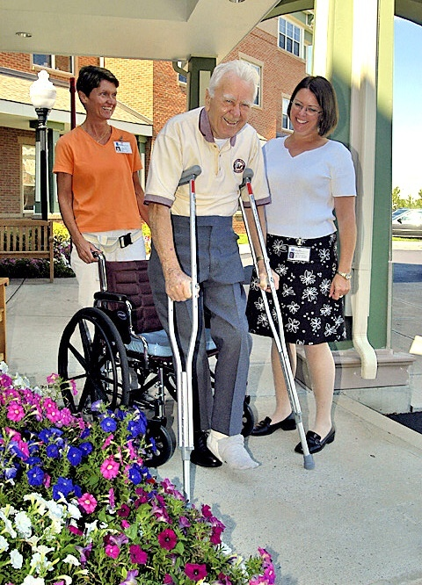
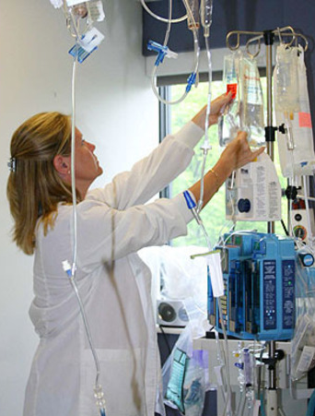
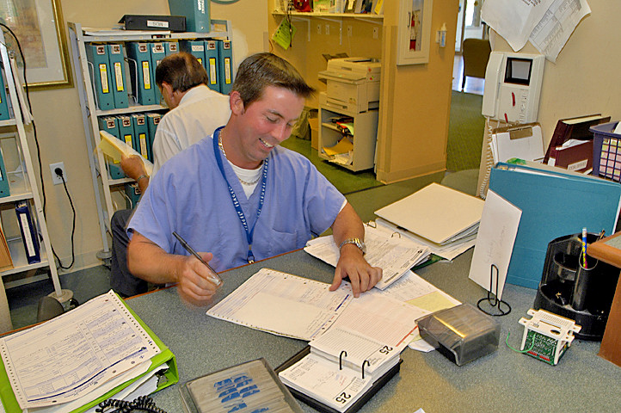
Care Transitions Education Project
Nurses From Across the Continuum LEARN TOGETHER!
Notes:
Kelly

Slide 32
Care Transitions Education Project
Panelists
Cherelyn Roberts, RN, BS
STAAR Initiative Program Manager, Holyoke Medical Center
Monique Belisle, RN
Assistant Director of Nursing, Linda Manor Extended Care Facility
Monica Gagnon, RN
Director of Business Development, Holyoke VNA/Hospice Life Care
Diane Brunelle, MSN, RN, NEA-BC
Vice President of Patient Care and Chief Nursing Officer Noble Hospital

Slide 33
Outcomes and Stories
Care Transitions Education Project
1. Increasing competency of practicing nurses and nursing students to lead and improve care transitions
2. Increasing mutual respect among nurses across care settings
3. Improving cross continuum coordination and collaboration
4. Demonstrating nurse-led quality improvement in care transition practice and work processes
Notes:
KELLY
Each panelists will comment on outcomes related to each of our project objectives
Increase competency (Cherelyn)
Increase mutual respect (Monique)
Improve coordination and collaboration (Monica)
Demonstrate nurse-led quality improvement (Diane)

Slide 34
Increasing Competency
Care Transitions Education Project
Activating front line staff to take action
Contributing to efforts focused on reducing avoidable hospital readmissions
Learning we need to focus on managers too
Integrating training into 5 year Delivery System Transformation Initiative
Notes:
CHERELYN
Increase competency of novice and experienced nurses and nursing students to lead and improve care transitions

Slide 35
Increasing Mutual Respect
Care Transitions Education Project
Focusing on patient-centered care leads to increased respect
Increased respect leading to more effective cross continuum communications
Breaking down historical/cultural hierarchies nurses give to roles across the continuum
Recognized as innovative approach
Notes:
Monique
Increase mutual respect among nurses across care settings in order to establish shared accountability for successful patient care outcomes (Monique)

Slide 36
Improving Coordination & Collaboration
Care Transitions Education Project
Gaining shared knowledge leads to shared patient goals
Better prepared workforce seeing connection between collaboration, communication and patient safety
Identifying new ways to collaborate with cross continuum partners (e.g., CHF Bootcamp)
Notes:
Jean
Improve coordination and collaboration among cross-continuum team members/inter-professional health providers and educators to achieve successful care transitions

Slide 37
Demonstrating Nurse-Led Quality Improvement
Care Transitions Education Project
Senior administration supporting training
Nurses recognizing their own power to lead, increase quality of care and reduce costs
Successfully reinstating “warm hand off” with cross continuum partners
Integrating training into new hire orientation
Notes:
Diane
Demonstrate nurse-led quality improvement in care transition practice and work processes that result in positive change (Diane)

Slide 38
How Can Your Organization Benefit?
Care Transitions Education Project
Attend May 13th Train-the-Trainer session
Use curriculum with cross continuum partners
Engage in future Community of Practice
Become a Phase 2 partner organization
Healthcare Workforce Transformation Fund
Evaluate linkage to readmissions & patient outcomes
Notes:
We hope today’s meeting has given you more information about the Care Transitions Education Project and you’re wondering how your organization can benefit?
We will be hosting a one day train-the-trainer session on May 13th. The session will include an overview of the curriculum toolkit and guidance on how to implement with cross continuum teams. The target audience is experienced nurse educators or other professionals with a strong care transitions background. We strongly recommend educators attend the training session. We will provide a copy of the curriculum to all who attend. We are limiting attendance to 75 at the May 13th event. See the Training Session Save the Date in your packet.
We encourage you to use the curriculum with your cross continuum partners. If you don’t send someone to the train-the-trainer, then the curriculum will be available online before the end of our grant in August 2014.
We plan to have a Community of Practice for those implementing the curriculum. We want to continue to learn how to refine the curriculum and will use the Community of Practice model to facilitate interaction among those who are implementing the curriculum.
Finally, we welcome organizations to join as Phase 2 partner organization. You’re heard Laurie and our panelists talk today about the pilot outcomes. Our Phase 2 efforts will focus on evaluating the linkage between the CTEP training and reducing avoidable hospital readmissions and increasing patient satisfaction. The Massachusetts Senior Care Foundation plans on submitting an application to the Healthcare Workforce Transformation Fund to support cross-continuum teams that want to implement the training.
Fill out the interest survey. We’re asking you three questions:
Based on today’s meeting do you have a clear understanding of the Care Transitions Education Project and how it can benefit your organization?
Are you interested in implementing the Care Transitions Education Project’s training in your organization?
Are you interested in having someone from your organization attend the May 13th Train-the-Trainer session?
Please fill out the Interest Survey and leave at the registration table on your way out

Slide 39
More Information?
Care Transitions Education Project
Kelly Aiken, Project Director, Regional Employment Board of Hampden County, kaiken@rebhc.org or 413-755-1369
Carolyn Blanks, Executive Director, Mass Senior Care Foundation, cblanks@maseniorcare.org or 617-558-0202
maseniorcarefoundation.org/Initiatives/Care_Transitions.aspx

