Slide 1

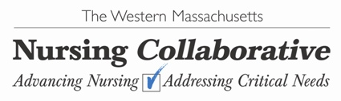
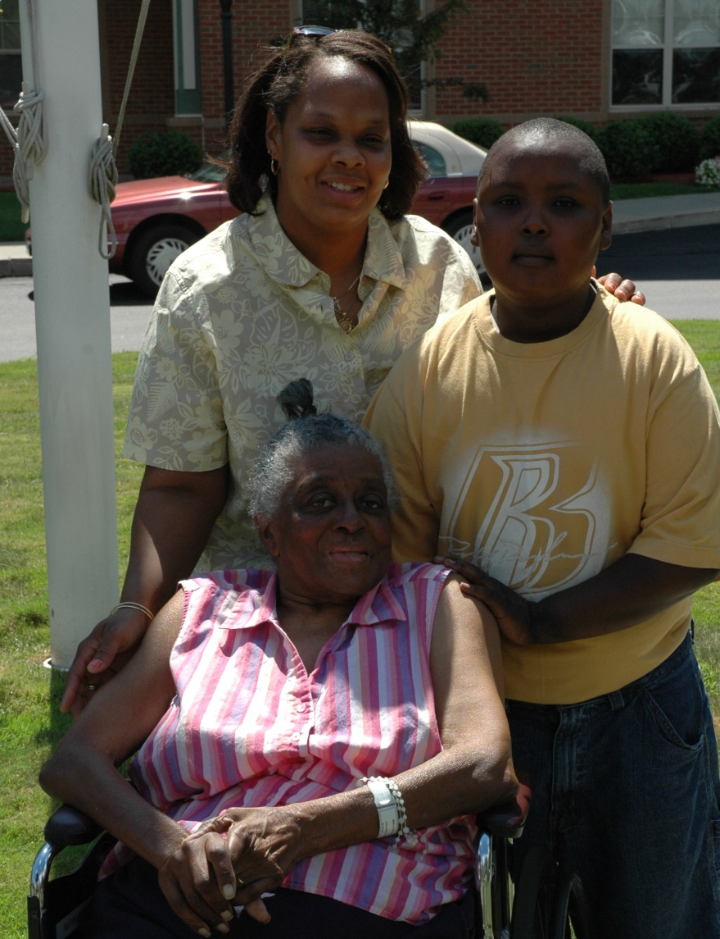
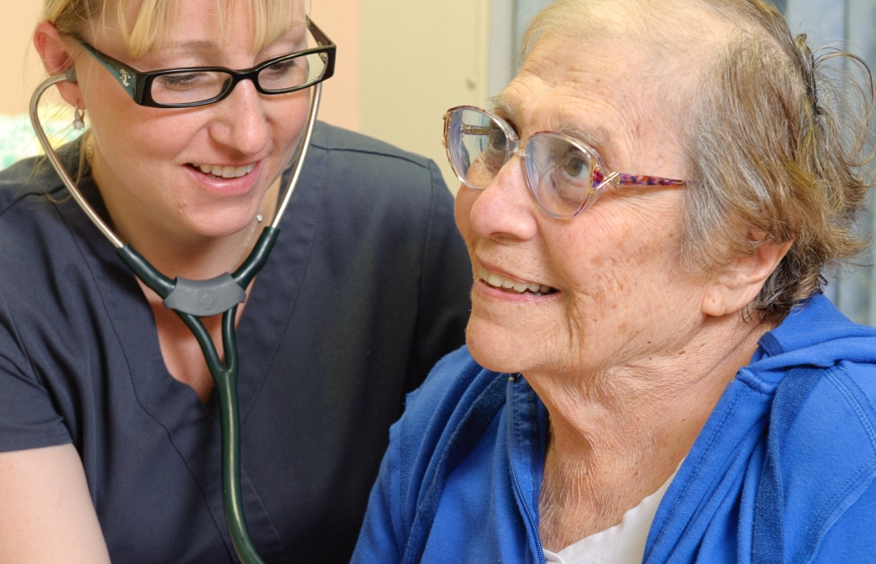

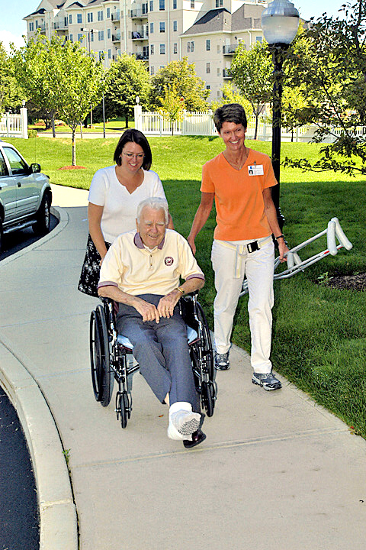
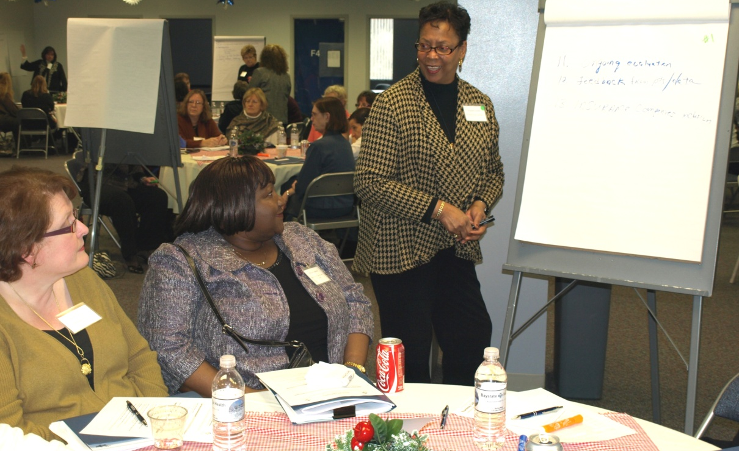


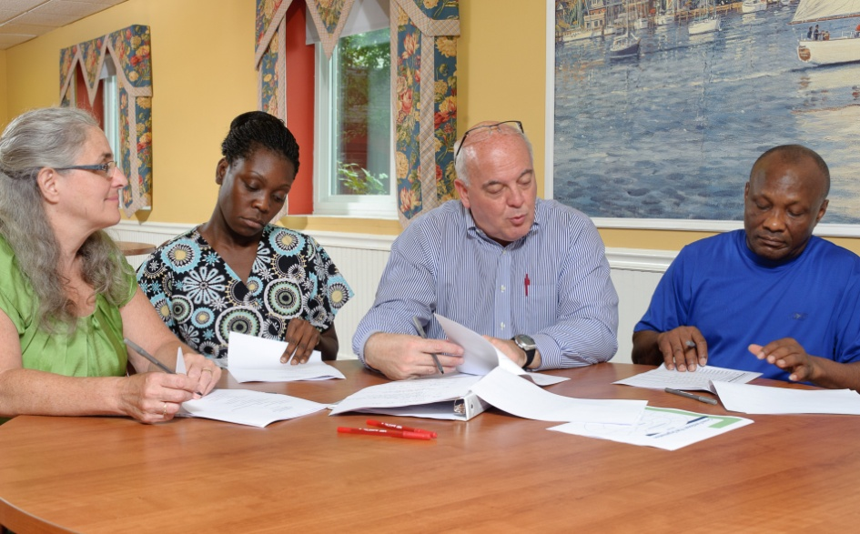
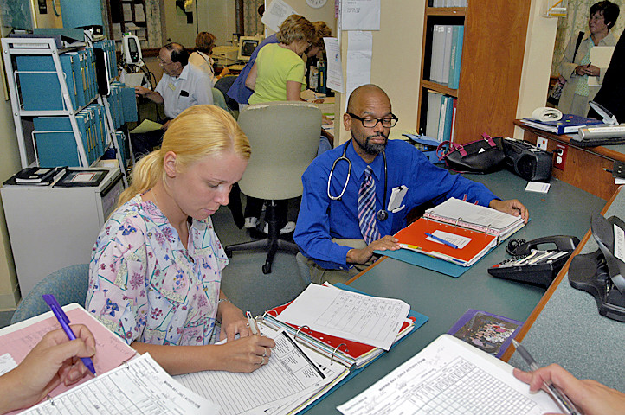
Care Transitions Education Project
Equipping Nurses to Lead Effective Patient-Centered Care Transitions
Project Scope
The Care Transitions Infrastructure
Care Transitions Curriculum
The Care Transitions Education Project will prepare and empower more nurses to lead and improve patient-centered care transitions.
The Massachusetts Senior Care Foundation and the Western Massachusetts Nursing Collaborative are working together to implement the 3 year project.
Massachusetts Strategic Plan for Care Transitions
Our vision is for Massachusetts communities to be served by interdisciplinary teams delivering safe, effective, and timely care that is culturally and linguistically appropriate within and across settings. (2010)
Project members are collaboratively developing a competency-based curriculum designed to expand nurses’ knowledge, skills and attitudes to lead effective care transitions.
The project conducted an extensive gap analysis and used the MA Nurse of the Future Competencies© and Inter-professional Collaborative Practice Competencies to guide curriculum development.
The curriculum is organized as a toolkit, with interactive and experiential learning activities, patient-centered case studies, readings, presentations, and other tools and resources.
Care Transitions: A Definition
The transfer of a patient from one setting of care or one set of providers to another during the course of an episode of care
All care settings are considered important to ensuring quality, patient-centered care
Project Goals
Increase the number of practicing nurses and nursing students prepared to assume leadership roles in care transitions
Increase nurses’ leadership in coordinating care and collaborating across the continuum to improve the quality of patient care transitions
Skills
Knowledge
Attitudes
Competency
3. Complement regional and state efforts to reduce avoidable hospital readmissions, improve quality care, reduce overall costs
Better Care
Better Health
Lower Cost
Curriculum Modules
The curriculum’s four modules each focus on the development of specific competencies:
Understanding Care Transitions across the Health Care Continuum
The Key Role of Nursing in Patient Care Transitions
Systems Thinking in Patient Care Transitions
Nursing Leadership in Care Transitions Quality Improvement
TRIPLE AIM
Nurses as Leaders
Nurses are leaders in Massachusetts statewide care transitions efforts
With healthcare reform, all nurses must be more actively engaged in improving care transitions as members of cross-continuum teams
Novice and experienced nurses must be better prepared and empowered to assume leadership roles in care transitions
Strategy
Year 1
9/11-9/12
Year 2-3
10/12-12/13
Year 3
1/14 - 8/14
Curriculum Development
Pilot & Evaluate Curriculum
Statewide Dissemination
Patient Tracer Experience
The curriculum includes a variety of experiential learning activities focused on tracing a patient from one care setting
to another to enable learners to understand a patient’s journey and different care settings
Develop competency-based care transitions curriculum for experienced and novice nurses
Train service and academic educators to implement curriculum with nurses from across settings and nursing students
Pilot curriculum with 30 cross-continuum partners in the context of care transitions quality improvement initiatives
Revise curriculum based on evaluation and package for statewide dissemination
Integrate with statewide care transitions efforts
Project Partners
Service
Baystate Health
Berkshire Health Systems
Cooley Dickinson Hospital & VNA
Commonwealth Care Alliance
Genesis Healthcare/Heritage Hall
Holyoke Health Center
Holyoke Medical Center
Holyoke VNA & Hospice Life Care
Jewish Geriatric Services
Noble Hospital and VNA
Mercy Medical Center
Mercy Home Care
MA Senior Care Association
Education
American International College
Elms College
Holyoke Community College
Greenfield Community College
Springfield Technical Community College
University of Massachusetts Amherst
Westfield State University
Philanthropic
Massachusetts Senior Care Foundation
Irene E. & George A. Davis Foundation
United Way of Pioneer Valley
Home Care Alliance of MA
Workforce Development
Regional Employment Board of Hampden County
Commonwealth Corporation
More Information?
Carolyn Blanks - Executive Director, Massachusetts Senior Care Foundation
cblanks@maseniorcare.org
Kelly Aiken - Project Director, Regional Employment Board of Hampden Co.
kaiken@rebhc.org

